Slide 1
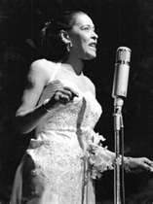
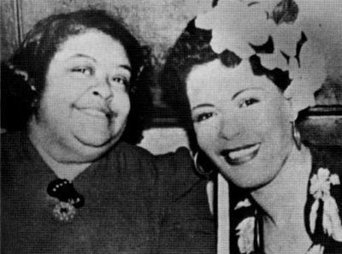
BILLIE HOLIDAY Lady Day

Slide 2
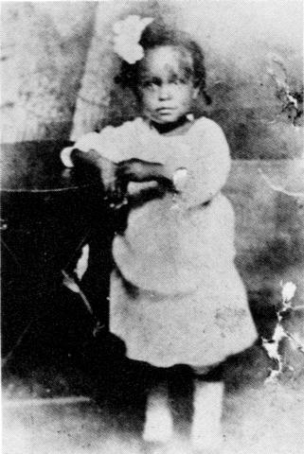
Rough Childhood
Born - Eleanora Fagan Gough, 7th April 1915, Philadelphia, Pennsylvania, but grew up mostly in Baltimore. -- She changed her name to Billy Holiday because of her admiration for film star Billie Dove.
She was an illegitimate daughter, also she yearned for her absent father, Clarence Holiday.
She moved to New York at the age of thirteen where she began her singing career.

Slide 3
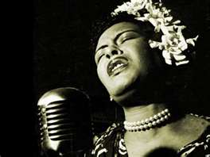
Billie Holiday
Sexuality
Ms. Holiday was molested and abused as a child, and at age twelve she was working as a prostitute.
Through out Ms. Holiday's life she had men that used her for fame, money, sex and drugs.
Many of her songs were based on her life.
When Ms. Holiday was asked about her opinion on the issue of lesbianism. According to Dr. Kim Purnell, “she made subtle allusion about her sexual relationship with women, particularly Marlene Dietrich and Tallulah Bankhead”.

Slide 4
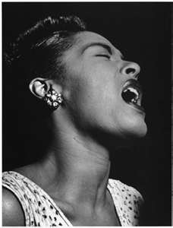
Billie Holiday
Start of Career
Ms. Holiday started singing while she was prostituting in a brothel.
She started singing songs by King Oliver, Bessie Smith and Louis Armstrong.
Her first audience were the white wealthier customers at Ms. Alice Dean's brothel.
In the Spring of 1937 she joined the Count Basie Orchestra
Billie Holiday was sought after by jazz promoter John Hammond.
Within two months she sang backup for Benny Goodman, Jack and Charlie Teagarden, Artie Bernstein, Dick McDonough, and Gene Krupa.

Slide 5
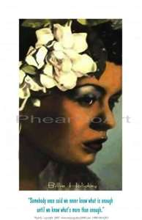
Billie Holiday
Harlem Renaissance
When Ms. Holiday joined Count Basie's group she already knew the other musicians because she recorded with a number of the band members.
During this time she hooked up Mr. Lester Young, and they became soul mates.
It was a friend Lester Young that called her “Lady”; and the name stuck “Lady Day”
After her opening at the Apollo Theater in New York and later at the Savoy Ballroom, she was flocked by new fans.
When Ms. Holiday went on tour they had to stay together in rented or borrowed homes because of Jim Crow laws.

Slide 6
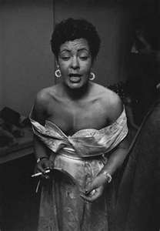
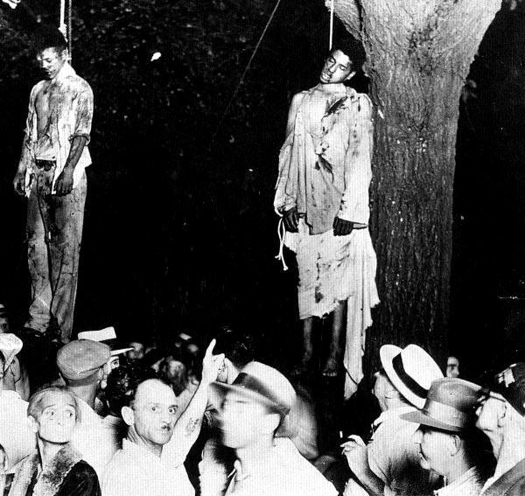
Billie holiday
Impact on history
Strange Fruit
http://www.youtube.com/watch?v=h4ZyuULy9zs&feature=player_detailpage
The song Strong Fruit (1939) was a powerful story about lynching of African-Americans in the South. The song was banned from some radio stations which made the song one of her signature ballads.
Ms. Holiday was known to be self-assured like a man, she was criticized by many for it.
Ms. Holiday was the first black woman to work with a white orchestra
When Ms. Holiday sang with the Artie Shaw Band she experienced racism.
Also sang with Benny Goodman in the early 1930s. The music was known as Swing style. The style help Ms. Holiday perfect her signature song style.

Slide 7
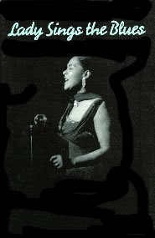
Billie Holiday
God bless the child
Only song that deviates from the subject of love and romance.
God Bless the Child addressed issues of economic and social class.
This song could be appreciated by blacks and whites, today.
http://www.youtube.com/watch?v=nk7bPZcHpa8&feature=player_detailpage

Slide 8
Billie Holiday
Rise and Fall
Ms. Holiday sang out to a sold out Carnegie Hall, first March 27, 1948 and then again 17 April 1948, which she broke her own box-office record.
Prior to her Carnegie Hall performance, Ms. Holiday had been released after serving nine and a half months of a drug conviction.
She also went into the recording studio to record “My Man” and “Porgy” on December 10, 1948
During this time she was very popular and somewhat of a celebrity.
Addiction to Heroin
Ms. Holiday’s addiction to drugs started when she was just a teenager, but during her later years came from her then lover Mr. Lester Young.
On May 27, 1947, Ms. Holiday was found guilty to heroin possession but she asked to be sent to a hospital fro her treatment. She was sent to Federal Reformatory for Women in Alderson, WV.
Ms. Holiday gave her final appearance May 25, 1959

Slide 9
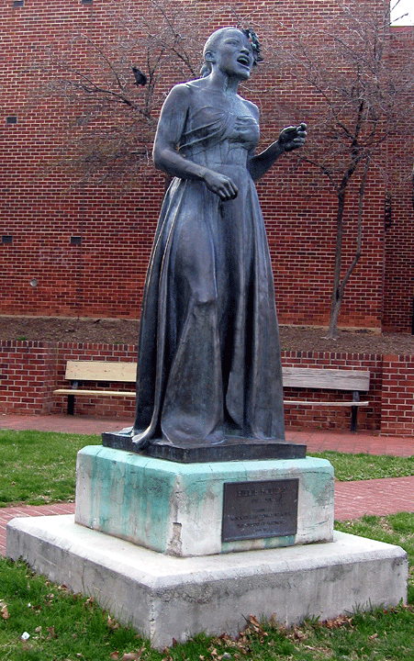
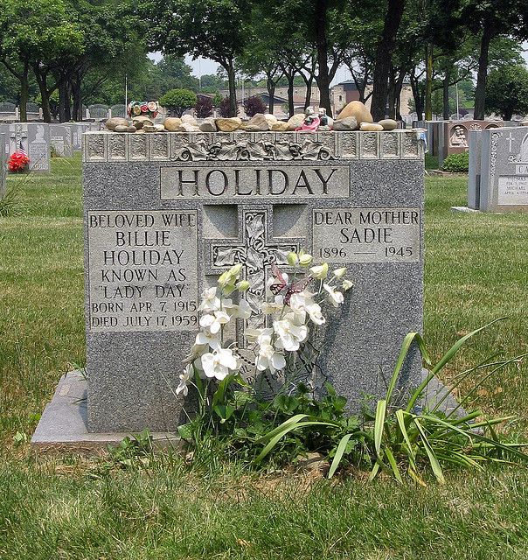
Billie Holiday
Conclusion
Ms. Holiday was admitted to the hospital for heart and liver problems, when she died on July 17, 1959
Over 3,000 people attended her funeral
In attendance were Benny Goodman, Gene Krupa. Tony Scott , Buddy Rogers and John Hammond
http://youtube/DFY4PZ5ZqEM

